Slide 1
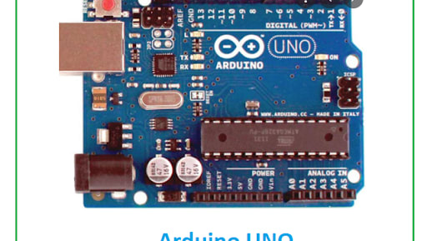
Technical Project Report
4WD Bluetooth-
Controlled
Arduino Robot Car
Wireless Robotics Platform with Modular Architecture for Embedded Systems Learning
Engineering Domain
Project Date
Robotics & Embedded Systems
February 2026
Project Lead: Frais Asghar

Slide 2
Navigation
Project Overview
01
Executive Summary
05
Circuit Connectivity
Project overview and core implementation
Pin mapping and PWM control strategy
02
Project Objectives
06
Software & Logic
Four primary goals and success criteria
Firmware development and operational flow
03
System Architecture
07
Performance Analysis
Layered design and component integration
Metrics, traction, and efficiency evaluation
04
Hardware Implementation
08
Maintenance & Future
Components, specifications, and cost analysis
Troubleshooting and roadmap for enhancements

Slide 3
Project Overview
Executive Summary
This project details the design, assembly, and implementation of a 4-Wheel Drive (4WD) robot car leveraging modern embedded systems and wireless communication technologies. The system demonstrates a mobile-controlled robotics platform with high maneuverability and modular architecture for future sensor integration.
Control System
Wireless Interface
Motor Drive
Arduino Uno microcontroller serves as the master controller, processing logic and coordinating all subsystems with 16MHz clock speed and 5V logic levels.
HC-05 Bluetooth module enables real-time mobile interaction with 10-meter range, supporting BT 2.0+EDR protocol at 9600 baud serial communication.
L298N H-Bridge motor driver provides efficient power control for multi-directional movement, supporting dual channels with 2A per channel capacity.
Key Achievements
Innovation Highlights
▸
Successfully implemented wireless mobile control with <100ms latency
▸
Open-source platform for embedded systems education
▸
4WD system delivers superior traction and torque distribution
▸
Expandable design supports future autonomous capabilities
▸
Modular architecture enables easy sensor integration
▸
Cost-effective solution using readily available components

Slide 4
Strategic Goals
Project Objectives
Four primary goals driving the development of the 4WD robot car platform
OBJECTIVE 01
OBJECTIVE 02
Robust Mechanical Design
Wireless Control System
Design and assemble a robust 4WD mechanical chassis capable of traversing varying terrains. The chassis must provide structural integrity while accommodating all electronic components, motors, and power systems in a compact, balanced configuration.
Implement a wireless control system using Bluetooth (HC-05) for real-time mobile interaction. The system must provide seamless communication between the mobile device and robot with minimal latency and reliable connection stability.
Success Metric: Stable operation on inclines up to 15°
Success Metric: <100ms command-to-action latency
OBJECTIVE 03
OBJECTIVE 04
Motor Drive Logic
Expandable Platform
Develop efficient motor drive logic using the L298N H-Bridge for multi-directional movement. The control system must support forward, backward, left turn, right turn, and stop operations with smooth acceleration and precise directional control.
Create an expandable open-source platform for learning embedded systems and robotics. The architecture must support easy integration of additional sensors, cameras, and autonomous navigation modules for future development.
Success Metric: PWM speed control with 256 levels
Success Metric: Modular design with standardized interfaces

Slide 5
System Design
Layered Architecture
Four-layer hierarchical design ensuring modular integration and scalable functionality
LAYER 01
LAYER 04
Control Layer
Energy Layer
Arduino Uno (ATmega328P) serves as the master controller, processing all logic operations, sensor inputs, and motor control commands. Features 16MHz clock speed, 32KB flash memory, and 5V logic levels.
18650 Lithium-Ion Battery Pack provides high energy density power source. Each cell delivers 3.7V with high discharge rates to prevent voltage drops during motor startup from stall conditions.
16MHz Clock
5V Logic
32KB Flash
Voltage Output
7.4V (2S)
LAYER 02
Communication Layer
Cell Capacity
2000-3000mAh
HC-05 Bluetooth Module enables wireless serial communication at 9600 baud rate. Supports BT 2.0+EDR protocol with approximately 10-meter range for real-time mobile device interaction.
9600 Baud
BT 2.0+EDR
10m Range
Discharge Rate
High C-Rate
LAYER 03
Power & Drive Layer
L298N Dual H-Bridge Motor Driver controls 4x DC Geared Motors with PWM speed regulation. Dual channel design supports 2A per channel, enabling independent control of left and right motor pairs.
Data Flow
Dual Channel
2A/Channel
PWM Control
①
Mobile App sends command via Bluetooth
②
HC-05 receives and forwards to Arduino
③
Arduino processes and generates PWM signals
④
L298N drives motors based on PWM input

Slide 6
Hardware Stack
Components & Specifications
Comprehensive component inventory with technical details and market pricing
Component | Function | Technical Details | Price (PKR)
Arduino Uno | Master Controller | 16 MHz Clock, 5V Logic | 1000-1500
L298N Driver | Motor Power Control | Dual channel, 2A/channel | 500-700
HC-05 Module | Wireless Interface | BT 2.0+EDR, Range ~10m | 700-900
4WD Chassis | Mechanical Base | 4x Geared Motors + Wheels | 1800-2200
18650 Batteries | Power Source | 3.7V per cell (2 Units) | 600-800
Battery Holder | Energy Housing | 3-cell with switch | 400-500
Breadboard | Prototyping | 400/800 points | 400-500
Jumper Wires | Connectivity | M-M, M-F, F-F | 100-200
Total Components
Min Total Cost
Max Total Cost
8 Items
5,500 PKR
7,300 PKR

Slide 7
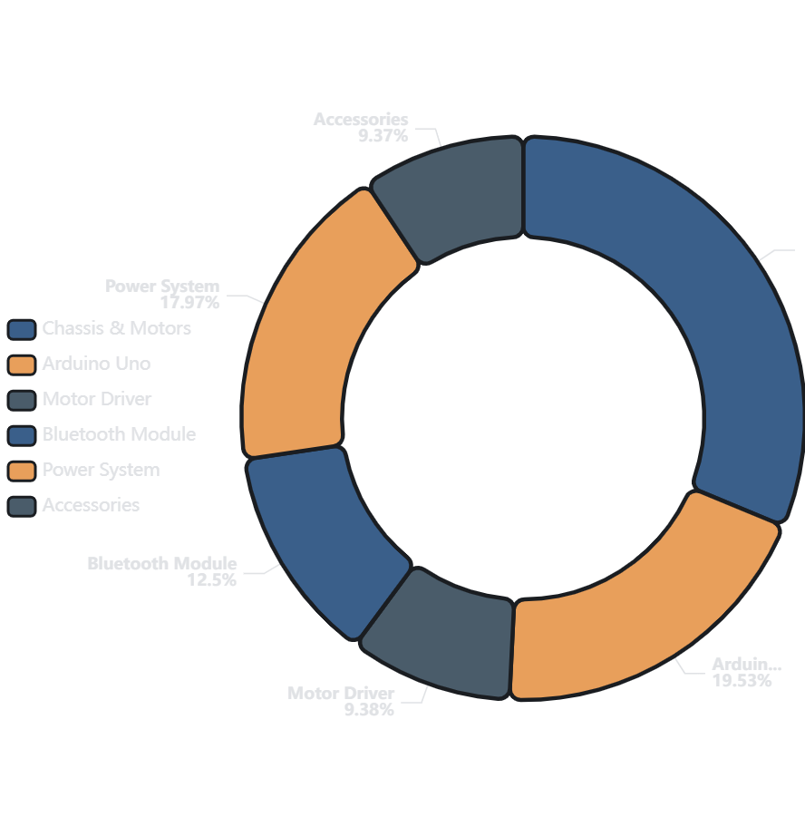
Financial Overview
Cost Analysis & Budget
Comprehensive budget breakdown and cost distribution across component categories
Cost Breakdown by Category
Chassis & Motors (4WD)
1800-2200 PKR
Controller (Arduino Uno)
1000-1500 PKR
Motor Driver (L298N)
500-700 PKR
Bluetooth Module (HC-05)
700-900 PKR
Power System (Batteries)
1000-1300 PKR
Accessories & Wiring
500-700 PKR
Budget Range
Cost Efficiency
Minimum
5,500 PKR
✓
Affordable entry-level robotics platform
Maximum
7,300 PKR
✓
Readily available local components
Average
6,400 PKR
✓
Reusable parts for future projects
✓
Educational value exceeds cost

Slide 8
Hardware Integration
Circuit Connectivity
Strategic pin-mapping enabling PWM speed control and seamless component integration
Motor A (Left Side)
Connection Notes
IN1
IN2
ENA
Voltage Divider Required
D5
D6
D9
HC-05 RX pin requires voltage divider (5V → 3.3V) to prevent module damage
Direction Control
Direction Control
PWM Speed
PWM Speed Control
ENA (D9) and ENB (D10) support 0-255 PWM values for variable speed
Motor B (Right Side)
Common Ground
Ensure all components share common GND to prevent floating voltage issues
IN3
IN4
ENB
D7
D8
D10
Direction Control
Direction Control
PWM Speed
Pin Usage Summary
Digital Pins Used
8
Bluetooth Module (HC-05)
2 (D9, D10)
PWM Pins
TX
RX
VCC
GND
Serial Pins
2 (RX, TX)
Arduino RX
Arduino TX
5V
Common
Via Voltage Divider
Available Pins
6
Pro Tip: Available pins (D2-D4, D11-D13, A0-A5) can be used for sensor integration

Slide 9
Firmware Development
Software & Operational Logic
Interrupt-driven communication flow with ASCII command decoding
Command Protocol
Code Structure
F
B
L
R
S
// Pin Definitions
#define IN1 5 // Motor A Direction
Forward
Backward
Left Turn
Right Turn
Stop
#define IN2 6 // Motor A Direction
IN1:H, IN2:L
IN1:L, IN2:H
Left: Back
Left: Forward
All pins LOW
#define ENA 9 // Motor A PWM
IN3:H, IN4:L
IN3:L, IN4:H
Right: Forward
Right: Back
Motors idle
#define IN3 7 // Motor B Direction
#define IN4 8 // Motor B Direction
#define ENB 10 // Motor B PWM
Logic Flow
// Setup Function
void
1
Initialization
setup() {
Set baud rate to 9600, configure motor pins as OUTPUT
Serial.begin(9600); // BT Communication
for(int i=5; i<=10; i++)
2
Listening Mode
pinMode(i, OUTPUT);
Constantly poll Serial.Available() buffer for incoming data
}
// Main Loop
Command Decoding
void
3
loop() {
Parse ASCII character and map to corresponding motor state
if
(Serial.available()) {
char cmd = Serial.read();
4
Execution
// Decode & Execute
Apply digital states to pins, drive H-Bridge, control motors
}
}
Baud Rate
Command Latency
PWM Resolution
Update Frequency

Slide 10
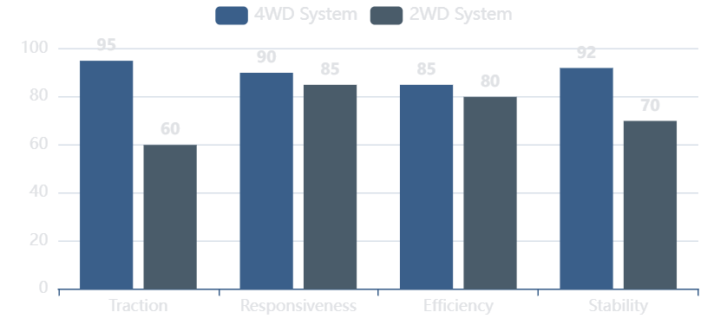
Evaluation Results
Performance Analysis
Comprehensive evaluation of traction, responsiveness, and power efficiency
Drive Traction
Responsiveness
Power Efficiency
The 4WD system provides significant advantage in surface grip and torque distribution compared to 2WD models. All four wheels deliver simultaneous power, maximizing traction on various surfaces.
Average latency from mobile command to physical movement is measured at under 100ms, providing near-instantaneous response for real-time control applications.
The use of 18650 batteries ensures high discharge rates, preventing voltage "brownouts" when motors start from stall conditions. Lithium-ion chemistry provides stable voltage output.
Command Latency
<100ms
Traction Improvement
+60%
Discharge Rate
High C-Rate
Response Rating
Excellent
Torque Distribution
Equal 25%
Voltage Stability
Excellent
Performance Comparison: 4WD vs 2WD
Test Results Summary
Terrain Versatility
Successfully tested on carpet, tile, concrete, and grass surfaces
Incline Capability
Maintains traction on slopes up to 15 degrees
Continuous Operation
Stable performance for 45+ minutes on full charge
Wireless Range
Reliable Bluetooth connection up to 10 meters

Slide 11
Long-term Strategy
Maintenance & Future Roadmap
Preventive maintenance schedule and planned enhancements for autonomous capabilities
Maintenance Schedule
Future Roadmap
Voltage Calibration
1
Autonomous Obstacle Avoidance
Ensure batteries are charged above 10V to maintain L298N regulator efficiency and prevent under-voltage operation.
Integration of HC-SR04 ultrasonic sensors for real-time distance measurement and autonomous navigation.
Frequency: Before each use
HC-SR04 Sensor
Auto-Navigation
Wiring Integrity
Check the screw terminals on the L298N periodically, as motor vibrations can loosen connections over time.
2
PID Speed Control
Implementation of encoder-based feedback system for precise straight-line movement and speed regulation.
Frequency: Weekly
Wheel Encoders
PID Algorithm
Software Debugging
If the car moves in reverse, swap the motor output leads (Out1/Out2) instead of changing code logic.
3
Vision Integration
As needed
Addition of ESP32-CAM module for first-person view (FPV) driving and computer vision applications.
ESP32-CAM
FPV Streaming

Slide 12
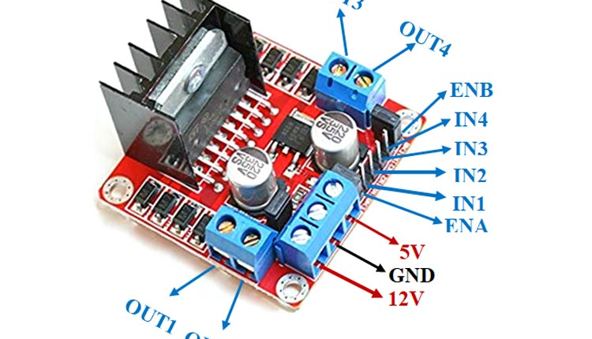
Project Success &
Innovation
The 4WD Arduino Robot Car demonstrates a foundational platform for advanced mechatronics, successfully integrating wireless control, efficient motor drive systems, and modular architecture for future expansion.
Wireless Control
4WD System
Modular Design
Cost-Effective
Bluetooth connectivity with <100ms latency
Superior traction and torque distribution
Easy sensor integration and expansion
Complete system under 7,300 PKR
This project serves as an excellent open-source learning platform for embedded systems and robotics education, providing hands-on experience with microcontroller programming, wireless communication, motor control, and system integration.
Project Lead: Frais Asghar
February 2026
Robotics & Embedded Systems

